Slide 1
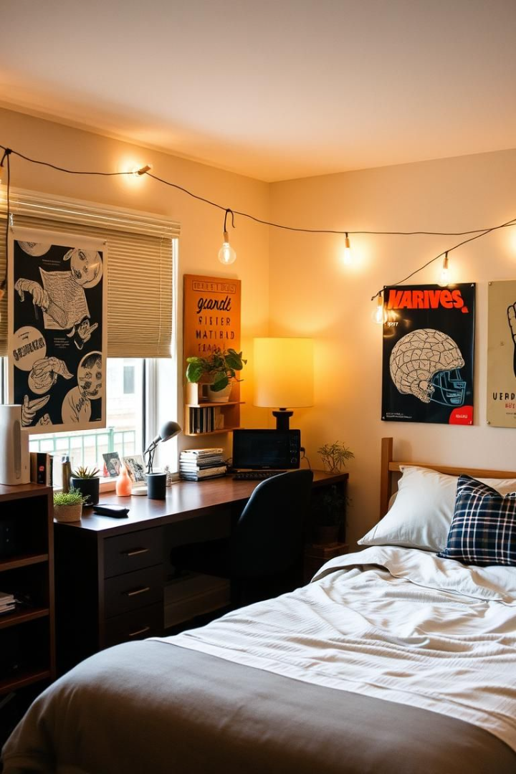
DormBuddy: Simplify, Connect, Thrive!
Team Members:
Krishna Gupta
Aniket Pandey
(Team Lead)
Harsh Aerndolkar
Manish Rathod

Slide 2

Problem Statement: Dorm Life Today
Challenges in Dorm Life
🏠 Roommate Task Coordination – Difficulty in managing shared responsibilities.
💰 Tracking Shared Expenses – Managing and splitting costs effectively.
🛠 Maintenance Requests – Delays and inefficiencies in issue resolution.
Roommate Conflicts
Inefficient Solutions
Time Consuming
60% of students report conflicts each semester.
Spreadsheets and group chats are time-consuming.
Students spend 2 hours per week on dorm tasks.

Slide 3
Project Objective
🚀 Develop a user-friendly platform for:
🤝 Roommate Matching
Helps users find compatible roommates based on lifestyle preferences.
Reduces conflicts by ensuring better roommate compatibility.
✅ Task Management
Organizes and assigns household chores efficiently.
Provides reminders and notifications to keep tasks on track.
💰 Expense Tracking
Simplifies cost-sharing for rent, utilities, and other expenses.
Ensures transparency with real-time tracking and automated calculations.
📱 Seamless User Experience
Intuitive interface for easy navigation.
Cross-platform accessibility for convenience on mobile and web.

Slide 4

Key Features
🤝 Roommate Matching
Matching based on preferences, lifestyle, and habits.
Ensures compatibility for a better living experience.
✅ Shared Task Management
Assign and track household chores effortlessly.
Automated reminders & notifications to keep tasks on schedule.
💰 Bill Splitting & Expense Tracking
Automatic cost division for rent, utilities, and shared expenses.
Transparency in spending with real-time tracking and reports.

Slide 5
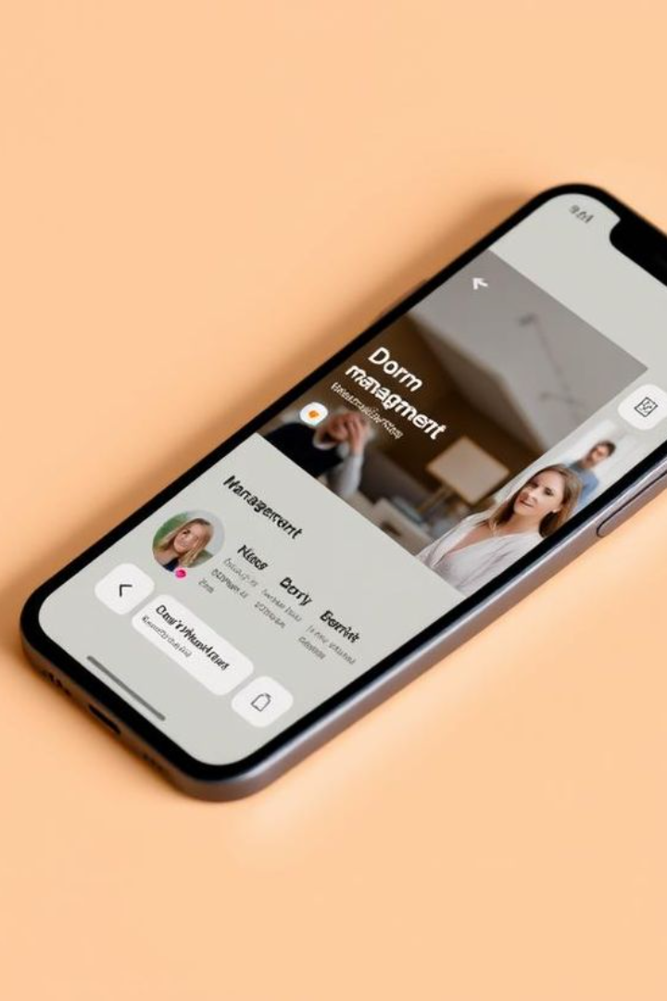
DormBuddy – Simplify, Connect, Thrive!
DormBuddy simplifies dorm management with an intuitive platform. It enables roommate matching, task management, expense tracking, and a maintenance portal for seamless communication and organization.
🤝 Roommate Matching
✅ Shared Task Management
💰 Bill Splitting
🛠️ Maintenance Portal

Slide 6
Challenges & Solutions
🔹 Challenge: Ensuring accurate roommate matching ✅ Solution: Preference and habit-based matching for better compatibility.
🔹 Challenge: Managing real-time notifications ✅ Solution: Firebase push notifications for instant updates.

Slide 7


Target Users
🎓 University & College Students
Students living in dorms who need better roommate coordination.
Helps manage tasks, expenses, and maintenance efficiently.
🏢 Hostel Managers & Administration
Simplifies dorm management with automated task tracking.
Streamlines maintenance requests and student communication.

Slide 8

Tech Stack Used
🚀 Frontend: React-Vite
Fast and optimized frontend framework for a smooth user experience.
Enhances performance with efficient rendering.
🛠 Backend: Express.js
Lightweight and flexible Node.js framework for handling server-side logic.
Ensures smooth API communication and request handling.
💾 Database: MongoDB
NoSQL database for efficient data storage and scalability.
Provides flexibility in managing roommate and expense records.

Slide 9
Future Scope
🚀 AI-Powered Roommate Suggestions
Advanced matching based on behavior patterns and preferences.
Improves roommate compatibility for a better living experience.
🏫 Integration with College Dorm Systems
Seamless connection with university dorm management.
Automates room assignments and administrative tasks.
💬 Chat System for Better Communication
Real-time messaging for roommates and dorm management.
Enhances coordination and quick issue resolution.

Slide 10

Conclusion: Revolutionizing Dorm Life
🎯 DormBuddy enhances dorm life by providing an efficient and convenient management system.
🤝 It bridges the gap between roommates and dorm management, ensuring better coordination, communication, and organization.
🚀 With features like roommate matching, task management, expense tracking, and a maintenance portal, DormBuddy simplifies daily dorm living.

